Slide 1
Reactive Programming
Spring WebFlux
June 2021

Slide 2
Reactive Programming
Reactive programming is simply to program using, and relying on, events.
It helps to make an application more responsive.
It is based on asynchronous and event-driven non-blocking programs, requiring online a small number of threads.
Data flow as Event/Message Driven stream
Back Pressure on Data Streams
Functional Style code

Slide 3
Tradicional REST API Design Imperative Programming
Blocking and Synchronous
Limit on the number of Concurrent users
No Back Pressure support
Notes:
To make calls asynchronous and non-blocking we have the folowing options, but have problems
Callbacks -> CallBack hell
Futures ->hard to compose multiple asynchronous operations
Completable Future -> not great fit to asynchronous call with multiple ítems and difficult error handling
No Back Pressure support -> if we have a request with lots of results applicationmcan crash with out of memory or client might be overwhelmed with huge data.

Slide 4
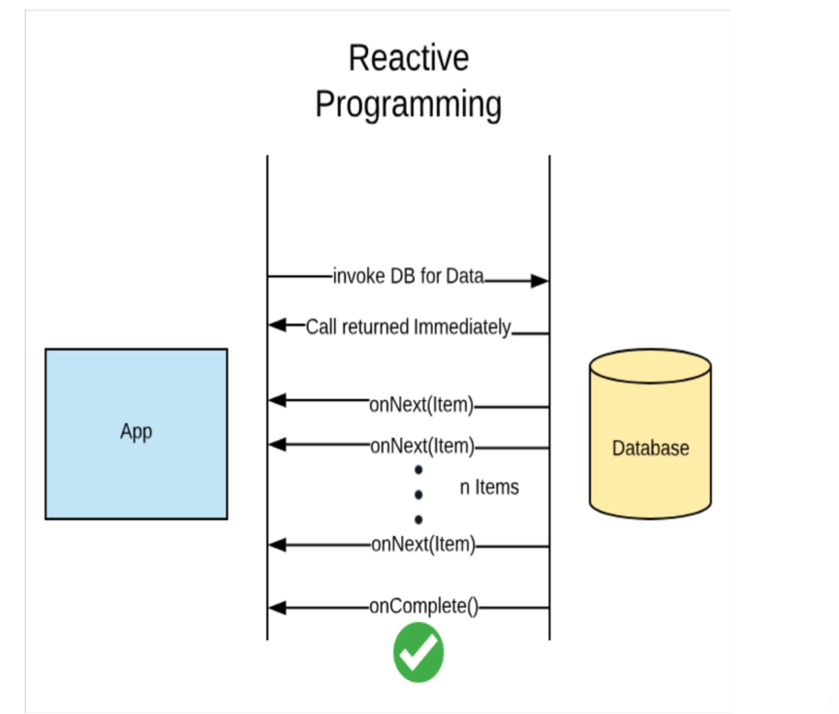
Better REST API Design Reactive Programming
Non-Blocking and Asynchronous
Move away from Thread per request model.
Use fewer threads.
Back Pressure support
Data flow was Event Driven stream

Slide 5
Data flow as an Event Driven stream Reactive Programming
One Event or Message for a every result item from Data Source.
One Event or Message for completion or error.
Happy path
Unhappy path
Notes:
Summary - Data flow as an Event Driven stream
• OnNext(item) – Data Stream events.
• OnComplete() -> Completion/Success event.
• OnError() -> Error Event

Slide 6
Back Pressure on Data Streams Reactive Programming
Notes:
If the data source is producing more data tan expected, we can send a feedback to “slow down”

Slide 7
Reactive Stream Specification
Publisher
subscribe(Subscriber<T> s)
Subscriber
onSubscribe(Suscription s)
onNext(T t)
onComplete()
onError(Throwable t)
Subscription
request(long n)
cancel()
Processor
https://www.reactive-streams.org/
https://www.reactivemanifesto.org/
Notes:
Reactive stream specification -> rules for reactive stream
Publisher (datasource )
Subscriber (consumer)
Subscription
request(long n) ← request a number of results (Back pressure )
cancel() ← cancelling the subscription form publisher

Slide 8
Reactive Libraries
RxJava https://github.com/ReactiveX/RxJava
Reactor https://projectreactor.io/
Flow Class – JDK 9 https://docs.oracle.com/javase/9/docs/api/java/util/concurrent/Flow.html

Slide 9
Project Reactor
Built and maintainer by Pivotal
Recommended Library to work with Spting Boot
Reactor Core
Core library for Project Reactor
Implementation of Reactive Streams Specification
Java 8 +
Uses Flux and Mono

Slide 10
Mono – 0 to 1 element react-core

Slide 11
Flux – 0 to N elements reactor-core

